Slide 1
SOLID Principles

Slide 2
Principles of Design
Core Principles of Design
Single Responsibility
Open-Closed Principle (OCP)
Liskov Substitution Principle
Interface Segregation Principle
Dependency Inversion Principle

Slide 3
Single Responsibility
Single Responsibility
“every class should have responsibility over a single part of the functionality provided by the software” – Wikipedia
A Class must always try to handle or deal with only ONE responsibility
What is Responsibility
REASON for CHANGE
“A class should have only one reason to change”
Notes:
The first SRP. What it says is – a single class must only take one single responsibility. You must avoid to combine multiple responsibilities into one class. What is responsibility here ? Its termed as reason for change. Putting everything together, a class must only have one reason for a change, but not multiple reasons.

Slide 4
Single Responsibility - Example
public class DBConnection{
static final String JDBC_DRIVER = "com.mysql.jdbc.Driver";
static final String DB_URL = "jdbc:mysql://localhost/EMP";
static final String USER = “it326";
static final String PASS = “it326";
Connection conn = null;
Statement stmt = null;
public DBConnection() {
try{
Class.forName("com.mysql.jdbc.Driver");
conn = DriverManager.getConnection(DB_URL,USER,PASS);
}catch(SQLException se){se.printStackTrace();}
public void dbQuery(String query) {
try{
stmt = conn.createStatement();
ResultSet rs = stmt.executeQuery(sql);
while(rs.next()){
// Creata an User Object based on the values
}
}catch(SQLException se){se.printStackTrace();}
}
How many responsibilities does this class take?
Connecting to DB
Query the DB
Creating an Object
How many reasons do a developer has to change this class ?
3
Violating the SRP

Slide 5
public class DBConnection {
private final String JDBC_DRIVER = "com.mysql.jdbc.Driver";
private final String DB_URL = "jdbc:mysql://localhost/EMP";
private final String USER = "it326";
private final String PASS = "it326";
Connection conn = null;
public DBConnection() {
try {
Class.forName(JDBC_DRIVER);
conn = DriverManager.getConnection(DB_URL, USER, PASS);
} catch (Exception se) {
se.printStackTrace();
}
}
public Connection getConnection() {
return conn;
}
}
public class DBQuery {
private DBConnection dbConn = null;
private Connection conn = null;
private Statement stmt = null;
public DBQuery() {
try{
dbConn = new DBConnection();
conn = dbConn.getConnection();
}catch(Exception se){
se.printStackTrace();
}
}
public ResultSet dbQuery(String query) {
ResultSet rs = null;
try{
stmt = conn.createStatement();
rs = stmt.executeQuery(query);
}catch(Exception se){
se.printStackTrace();
}
return rs;
}
}
public class ObjectCreator {
public static void query2Object(ResultSet result) {
try {
while (result.next()) {
// Create an User Object using CreatorClass
}
} catch (Exception se) {
se.printStackTrace();
}
}
}

Slide 6
Open-Closed Principle
Open-Closed Principle
“Open for extension, closed for modification”
A class or an entity must be closed for any potential changes, BUT must be open or allowed to be extend to deal with requirement changes
Why cant we just change the code
Re-test the component
Make sure old functionality still works
Sometime, this may not even be an option

Slide 7
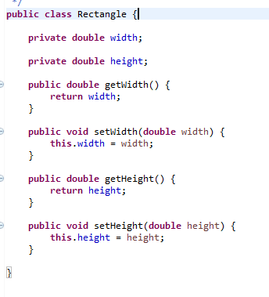
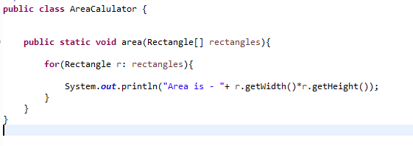
Open-Closed Principle - Example
Example,
Rectangle and AreaCalculator
Now,
You need to include Square
Later, include Circle or Triangle or Columbus
Create
Square and change AreaCalculator
Circle and change AreaCalculator

Slide 8
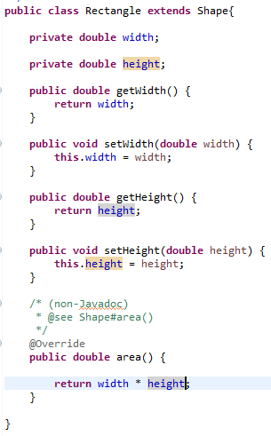

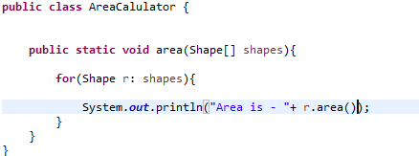
Open-Closed Principle - Example
Solution,
Define an abstraction

Slide 9
The Open-Closed Principle
How?
Separate interface from implementation
Let all other classes work on interfaces
To extend, create a new implementation for the same interface

Slide 10
The Liskov Substitution Principle
Liskov Substitution Principle
“Subclasses should be substitutable for base classes”
CODE or the BEHAVIOR that works with base class should not break with derived class
How does this happen? Irresponsible overriding
Maintain backward compatibility
Notes:
A subclass must be able to substitute a base class.

Slide 11
The Liskov Substitution Principle
Liskov Substitution Principle
Violated, when
Replacing a superclass with a subclass object changes the program behavior in unexpected ways
How does this happen?
Returning an object that’s incompatible with the object returned by the superclass behavior
Throwing a new exception that’s not thrown by the superclass behavior
Changing the semantics or introducing side effects that are not part of the superclass’s behavior
Notes:
A subclass must be able to substitute a base class.

Slide 12
The Liskov Substitution Principle - Example
Example: Bird, Sparrow, Ostrich
public class Bird {
public void eat() {
System.out.println("Birds eat all kinds of food");
}
public void fly() {
System.out.println("Birds fly");
} }

Slide 13
The Liskov Substitution Principle - Example
Example: Bird, Sparrow, Ostrich
public class Sparrow extends Bird {
@Override
public void eat() {
System.out.println("Sparrow like grains more than any food");
}
@Override
public void fly() {
System.out.println("Sparrow fly very fast for short distances");
}
}

Slide 14
The Liskov Substitution Principle - Example
Example: Bird, Sparrow, Ostrich
public class BirdSparrowTest {
public static void main(String args[]) {
Bird generalBird = new Bird();
generalBird.fly();
generalBird.eat();
generalBird = new Sparrow();
generalBird.fly();
generalBird.eat();
}
}

Slide 15
The Liskov Substitution Principle - Example
Example
Bird, Sparrow, Ostrich
Breaking LSP principle
The subclass is throwing an exception.
Ostrich violates the fly behavior of the
base class, Bird.
public class Ostrich extends Bird {
@Override
public void fly() {
throw new IllegalAccessException("I cannot fly");
}
@Override
public void eat() {
System.out.println("Ostrich like fruits more than any food");
}
}

Slide 16
The Liskov Substitution Principle - Example
public class BirdPassTest {
public static void main(String args[]) {
List<Bird> birds = new ArrayList<Bird>();
for (int i = 0; i < 20; i++) {
int d = new Double(Math.random() * 20 + 1).intValue();
if (d % 2 == 0)
birds.add(new Hawk());
else if (d % 4 == 0)
birds.add(new Sparrow());
else
birds.add(new Ostrich());
}
for (Bird b : birds) {
/**
* This is a patch work. Each time there is a bird object that doesnt fly,
* developer needs to write an if condition to ensure you cannot call "fly"
* method on that object. For example, when you add Penguin, you need to write
* another if condition. This will get messy and a conditional structure.
*
* This means the Ostrich cannot replace the base, Bird, class or code should
* not know what kind of Bird object is being used.
*/
if (!(b instanceof Ostrich))
b.fly();
}
}
}

Slide 17
The Liskov Substitution Principle - Example
Solution
Remove the behavior that cannot be applied to all the sub-classes – fly in this context
public class Bird {
public void eat() {
System.out.println("Birds eat food");
} }

Slide 18
The Liskov Substitution Principle - Example
Solution
Design an abstraction for the specialized behavior– fly in this context.
Only classes that can have the behavior will implement the abstraction
public class Sparrow extends Bird implements Fly {
@Override
public void eat() {
System.out.println("Sparrow like grains more than any food");
}
@Override
public void fly() {
System.out.println("Sparrow fly very fast for short distances");
}
}
public interface Fly {
public void fly();
}

Slide 19
The Liskov Substitution Principle - Example
Solution
Remove the behavior that cannot be applied to all the sub-classes – fly in this context.
public class Ostrich extends Bird {
@Override
public void eat() {
System.out.println("Ostrich like fruits more than any food");
}
}

Slide 20
The Liskov Substitution Principle - Example
public class BirdPassTest {
public static void main(String args[]) {
List<Bird> birds = new ArrayList<Bird>();
for (int i = 0; i < 20; i++) {
int d = new Double(Math.random() * 20 + 1).intValue();
if (d % 2 == 0)
birds.add(new Hawk());
else if (d % 4 == 0)
birds.add(new Sparrow());
else
birds.add(new Ostrich());
}
for (Bird b : birds) {
b.eat();
}
}
}

Slide 21
Principles of component design Interface Segregation Principle
“Many client-specific interfaces better than one general-purpose interface”
Every interface should be cohesive
Divide interface if it is too general
Clients MUST NOT be forced to implement the methods of an interface if they don’t want to

Slide 22
Interface Segregation Principle - Example
Example
Machine Interface
AllInOne implements the interface
public interface Machine {
public void print();
public void staple();
public void scan();
public void photoCopy();
}
public class AllInOne implements Machine {
@Override public void print() { System.out.println("Printing Job"); }
@Override public void staple() { System.out.println("Stapling Job"); }
@Override public void scan() { System.out.println("Scan Job"); }
@Override public void photoCopy() { System.out.println("Photo Copy"); }
}

Slide 23
Interface Segregation Principle - Example
Example
ScanMachine implements the interface
But it is FORCED to override other methods
public class ScanMachine implements Machine {
@Override public void print() {}
@Override public void staple() {}
@Override public void scan() { System.out.println("Scan Job"); }
@Override public void photoCopy() {}
}

Slide 24
Interface Segregation Principle - Example
Solution:
Break down Machine interface
Define multiple small and focused interfaces
public interface Printer {
public void print();
}
public interface Scanner {
public void scan();
}
public interface Stapler {
public void staple();
}
public interface PhotoCopier {
public void photoCopy();
}

Slide 25
Interface Segregation Principle - Example
Now
AllInOne and ScanMachine implements the required interfaces
public class AllInOne implements Printer,Scanner, Stapler, PhotoCopier {
@Override public void print() { System.out.println("Printing Job"); }
@Override public void staple() { System.out.println("Stapling Job"); }
@Override public void scan() { System.out.println("Scan Job"); }
@Override public void photoCopy() { System.out.println("Photo Copy"); }
}
public class ScanMachine implements Scanner{
@Override public void scan() { System.out.println("Scan Job"); }
}

Slide 26
Principles of component design Dependency Inversion Principle
“Depend on abstractions, not implementations”
Abstractions are the binding contract irrespective of implementation
Design based on contract, not how it is fulfilled
“How it is fulfilled” can be changed without changing contract

Slide 27
Dependency Inversion Principle - Example
Example
PrintJob - Reads the Word document and sends it contents to the printer
Problem ?
How can I print PDF or XML or HTML or Text
How can I print it to a PDFPrinter, OpenOfficePrinter, LaserPrinter etc.
public Class PrintJob {
public void print(WordDocument doc, DotPrinter P)
{
String data = doc.getData();
p.printData(data);
}
}

Slide 28
Dependency Inversion Principle - Example
Solution
Define Abstractions
For ?
Document & Printer
public interface Document {
public String getData();
}
public interface Printer{
public void printData(String data);
}
public Class PrintJob {
public void print(Document doc, Printer P)
{
String data = doc.getData();
p.printData(data);
}
}

Slide 29
Dependency Inversion Principle - Example
Solution
Use the abstraction
public Class WordDocument implements Document {
public String getData(){
// Return the contents of // Word Document
}
}
public Class PDFDocument implements Document {
public String getData(){
// Return the contents of // PDFDocument
}
}
public class PDFPrinter implements Printer{
public void printData(String data){
}
}
public class XMLPrinter implements Printer{
public void printData(String data){
}
}

Slide 30
Thank you
Questions, Comments, and Feedback

